Slide 1
Technology Mapping
F
t₅’
Example:
  t₁ = a + bc;
  t₂ = d + e;
  t₃ = ab + d;
  t₄ = t₁t₂ + fg;
  t₅ = t₄h + t₂t₃;
  F = t₅’;
  This shows an unoptimized set of logic equations consisting of 16 literals
t₄h + t₂t₃
t₁t₂ + fg
a+bc
d+e
ab+d

Slide 2
Optimized Equations
Using technology independent optimization, these equations are optimized using only 14 literals:
  t₁ = d + e;
  t₂ = b + h;
  t₃ = at₂ + c;
  t₄ = t₁t₃ + fgh;
  F = t₄’;
F
t₄’
F
t₅’
t₁t₃ + fgh
at₂ +c
t₄h + t₂t₃
t₁t₂ + fg
d+e
b+h
a+bc
d+e
ab+d

Slide 3
Optimized Equations
Implement this network using a set of gates which form a library. Each gate has a cost (i.e. its area, delay, etc.)

Slide 4
Technology Mapping
Two approaches:
Rule-Based [LSS]
Algoritmic [DAGON, MISII]
  Represent each function of a network using a set of base functions. This representation is called the subject graph.
    Typically the base is 2-input NANDs and inverters [MISII].
    The set should be functionally complete.
  Each gate of the library is likewise represented using the base set. This generates pattern graphs
    Represent each gate in all possible ways

Slide 5
Subject graph
F
F
Subject
graph of
2-input
NANDs and
invertors
t₄’
f
t₁t₃ + fgh
at₂ +c
c
d’
e’
g
h
a
d+e
b+h
b’
h’

Slide 6
Algorithmic Approach
A cover is a collection of pattern graphs such that
  every node of the subject graph is contained in one (or more) pattern graphs
  each input required by a pattern graph is actually an output of some other graph (i.e. the inputs of one gate must exists as outputs of other gates.)
For minimum area, the cost of the cover is the sum of the areas of the gates in the cover.
Technology mapping problem: Find a minimum cost covering of the subject graph by choosing from the collection of pattern graphs for all the gates in the library.

Slide 7
Subject Graph
f
g
  t₁ = d + e;
  t₂ = b + h;
  t₃ = at₂ + c;
  t₄ = t₁t₃ + fgh;
  F = t₄’;
d
e
F
h
b
a
c

Slide 8
Pattern Graphs for the IWLS Library
inv(1)
nand2(2)
nand3 (3)
nor3 (3)
nor(2)
aoi21 (3)
oai22 (4)
xor (5)

Slide 9
Subject graph covering
f
g
  t₁ = d + e;
  t₂ = b + h;
  t₃ = at₂ + c;
  t₄ = t₁t₃ + fgh;
  F = t₄’;
d
e
F
h
b
a
Total cost = 23
c

Slide 10
Better Covering
and2(3)
f
g
aoi22(4)
  t₁ = d + e;
  t₂ = b + h;
  t₃ = at₂ + c;
  t₄ = t₁t₃ + fgh;
  F = t₄’;
or2(3)
d
e
F
h
or2(3)
b
nand2(2)
a
Total area = 19
c
nand2(2)
inv(1)

Slide 11
Alternate Covering
f
nand3(3)
g
  t₁ = d + e;
  t₂ = b + h;
  t₃ = at₂ + c;
  t₄ = t₁t₃ + fgh;
  F = t₄’;
oai21(3)
and2(3)
d
e
F
h
b
oai21 (3)
a
Total area = 15
c
nand2(2)
inv(1)

Slide 12
Technology mapping using DAG covering
Input
  Technology independent, optimized logic network
  Description of the gates in the library with their cost
Output
  Netlist of gates (from library) which minimizes total cost
General Approach
  Construct a subject DAG for the network
  Represent each gate in the target library by pattern DAG’s
  Find an optimal-cost covering of subject DAG using the collection of pattern DAG’s

Slide 13
Technology mapping using DAG covering
Complexity of DAG covering:
  NP-hard
  Remains NP-hard even when the nodes have out degree ≤ 2
  If subject DAG and pattern DAG’s are trees, an efficient algorithm exists

Slide 14
DAG covering as a binate covering problem
Compute all possible matches {m_{k} } (ellipses in fig.) for each node
Using a variable m_{i} for each match of a pattern graph in the subject graph, (m_{i} =1 if match is chosen)
Write a clause for each node of the subject graph indicating which matches cover this node. Each node has to be covered.
  e.g., if a subject node is covered by matches {m₂, m₅, m₁₀ }, then the clause would be (m₂ + m₅ + m₁₀).
Repeat for each subject node
and take the product over all
subject nodes. (CNF)
m₁ m₂ . . . m_{k}
n₁
n₂
.
.
.
n_{l}
nodes

Slide 15
DAG covering as a binate covering problem
Any satisfying assignment guarantees that all subject nodes are covered, but does not guarantee that other matchs chosen create outputs needed as inputs needed for a given match.
Rectify this by adding additional clauses.
not an output
of a chosen
match

Slide 16
DAG covering as a binate covering problem
Let match m_{i} have subject nodes s_{i1},…,s_{in} as n inputs. If m_{i} is chosen, one of the matches that realizes s_{ij} must also be chosen for each input j ( j not a primary input).
Let S_{ij} be the disjunctive expression in the variables m_{k} giving the possible matches which realize s_{ij} as an output node. Selecting match m_{i} implies satisfying each of the expressions S_{ij} for j = 1 … n.
This can be written
(m_{i} ⇒ (S_{i1} … S_{in} ) )⇔ (‾m_{i} + (S_{i1} … S_{in} ) ) ⇔ ((‾m_{i} + S_{i1}) … (‾m_{i} + S_{in} ) )

Slide 17
DAG covering as a binate covering problem
Also, one of the matches for each primary output of the circuit must be selected.
An assignment of values to variables m_{i} that satisfies the above covering expression is a legal graph cover
For area optimization, each match m_{i} has a cost c_{i} that is the area of the gate the match represents.
The goal is a satisfying assignment with the least total cost.
  Find a least-cost prime:
    if a variable m_{i} = 0 its cost is 0, else its cost in c_{i}
    m_{i} = 0 means that match i is not chosen

Slide 18
Binate Covering
This problem is more general than unate-covering for two-level minimization because
  variables are present in the covering expression in both their true and complemented forms.
The covering expression is a binate logic function, and the problem is referred to as the binate-covering problem.
This problem has appeared before:
  As state minimization of incompletely specified finite-state machines [Grasselli-65]
  As a problem in the design of optimal three level NAND-gate networks [Gimpel-67]
  In the optimal phase assignment problem [Rudell-86]

Slide 19
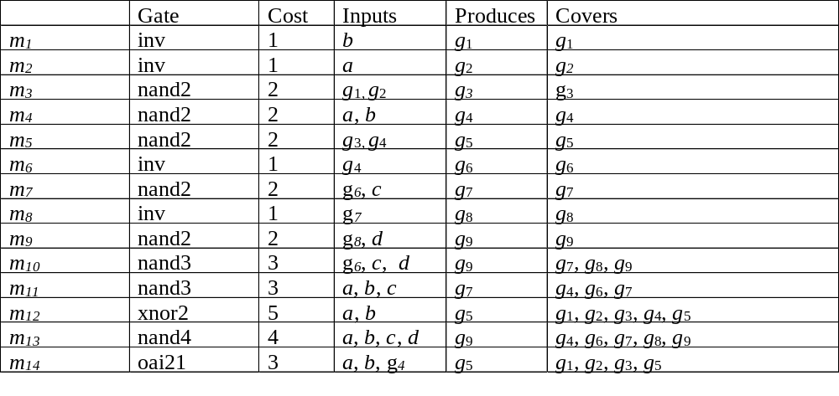
Binate Covering: Example
1
3
o₁
5
2
a
b
4
6
c
7
8
d
9
o₂

Slide 20
Binate Covering: Example
Generate constraints that each node g_{i} be covered by some match.
(m₁ + m₁₂ + m₁₄) (m₂ + m₁₂ + m₁₄) (m₃ + m₁₂ + m₁₄)
(m₄ + m₁₁ + m₁₂ + m₁₃) (m₅ + m₁₂ + m₁₃)
(m₆ + m₁₁ + m₁₃) (m₇ + m₁₀ + m₁₁ + m₁₃)
(m₈ + m₁₀ + m₁₃) (m₉ + m₁₀ + m₁₃)
To ensure that a cover leads to a valid circuit, extra clauses are generated.
  For example, selecting m₃ requires that
    a match be chosen which produces g₂ as an output, and
    a match be chosen which produces g₁ as an output.
  The only match which produces g₁ is m₁, and the only match which produces g₂ is m₂

Slide 21
Binate Covering: Example
The primary output nodes g₅ and g₉ must be realized as an output of some match.
  The matches which realize g₅ as an output are m₅, m₁₂, m₁₄;
  The matches which realize g₉ as an output are m₉, m₁₀, m₁₃
Note:
  A match which requires a primary input as an input is satisfied trivially.
  Matches m₁,m₂,m₄,m₁₁,m₁₂,m₁₃ are driven only by primary inputs and do not require additional clauses

Slide 22
Binate Covering: Example
Finally, we get
(‾m₃ + m₁) (‾m₃ + m₂) (m₃ +‾m₅) (‾m₅ + m₄) (‾m₆ + m₄)
(‾m₇ + m₆) (‾m₈ + m₇) (m₈ +‾m₉) (‾m₁₀ + m₆)
(‾m₁₄ + m₄) (m₅ + m₁₂ + m₁₄) (m₉ + m₁₀ + m₁₃)
The covering expression has 58 implicants
The least cost prime implicant is
‾m₃ ‾m₅ ‾m₆ ‾m₇ ‾m₈ ‾m₉ ‾m₁₀ m₁₂ m₁₃ ‾m₁₄
This uses two gates for a cost of nine gate units. This corresponds to a cover which selects matches m₁₂ (xor2) and m₁₃ (nand4).

Slide 23
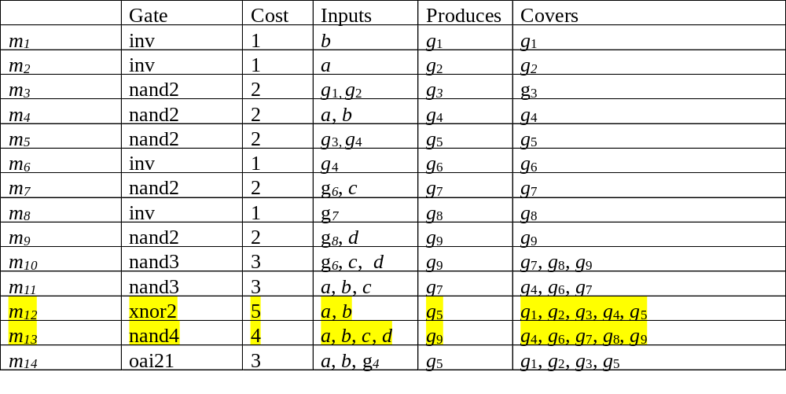
Binate Covering: Example
m₃ ‾m₅ ‾m₆ ‾m₇ ‾m₈ ‾m₉ ‾m₁₀ m₁₂ m₁₃ ‾m₁₄
1
3
o₁
  Note that the node g₄ is covered by both matches
5
2
a
b
4
6
c
7
8
d
9
o₂

Slide 24
Complexity of DAG covering
More general than unate covering
  Finding least cost prime of a binate function.
    Even finding a feasible solution is NP-complete (SAT).
    For unate covering, finding a feasible solution is easy.
  DAG-covering: covering + implication constraints
Given a subject graph, the binate covering provides the exact solution to the technology-mapping problem.
  However, better results may be obtained with a different initial decomposition into 2-input NANDS and inverters
Methods to solve the binate covering formulation:
  Branch and bound [Thelen]
  BDD-based [Lin and Somenzi]
Even for moderate-size networks, these are expensive.

Slide 25
Optimal Tree Covering by Trees
If the subject DAG and primitive DAG’s are trees, then an efficient algorithm to find the best cover exists
Based on dynamic programming
First proposed for optimal code generation in a compiler

Slide 26
Optimal Tree Covering by Trees
Partition subject graph into forest of trees
Cover each tree optimally using dynamic programming
Given:
  Subject trees (networks to be mapped)
  Forest of patterns (gate library)
Consider a node N of a subject tree
Recursive Assumption: for all children of N, a best cost match (which implements the node) is known
Cost of a leaf of the tree is 0.
Compute cost of each pattern tree which matches at N,
  Cost = SUM of best costs of implementing each input of pattern
  plus the cost of the pattern
Choose least cost matching pattern for implementing N

Slide 27
Optimum Area Algorithm
Optimal_area_cover(node) {
/* find optimal cover for all nodes below “node” */
foreach input of node {
optimal_area_cover(input); /* thus satisfies recursive assumption */
}
/* Using these, find the best cover at “node” */
node→area = INFINITY;
node→match = 0;
foreach match at node {
area = match→area;
foreach pin of match {
area = area + pin→area;
}
if (area < node→area) {
node→area = area;
node→match = match;
}}}

Slide 28
Tree Covering in Action
library
nand2 = 3
inv = 2
nand3 = 4
nand4 = 5
and2 = 4
aio21 = 4
oai21 = 4
nand2(3)
aoi21
nand2(8)
nand2(13)
inv(2)
inv(20)
aoi21(18)
inv(2)
nand4
inv(6)
and2(8)
nand2(21)
nand3(22)
nand4(18)
inv(5)
and2(4)
nand2(3)
nand2(21)
nand3(23)
nand4(22)
nand2(7)
nand3(4)
nand4

Slide 29
Complexity of Tree Covering
Complexity is controlled by finding all sub-trees of the subject graph which are isomorphic to a pattern tree.
Linear complexity in both size of subject tree and size of collection of pattern trees

Slide 30
Partitioning the subject DAG into trees
Trivial partition: break the graph at all multiple-fanout points
  leads to no “duplication” or “overlap” of patterns
  drawback - sometimes results in many of small trees
Leads to
3 trees

Slide 31
Partitioning the subject DAG into trees
Single-cone partition:
  from a single output, form a large tree back to the primary inputs;
  map successive outputs until they hit match output formed from mapping previous primary outputs.
    Duplicates some logic (where trees overlap)
    Produces much larger trees, potentially even better area results
output
output

Slide 32
Logic Decomposition and
Technology Mapping
Lehman-Watanabe Method
Common Approach:
Phase 1: Technology independent optimization
  commit to a particular Boolan network
  algebraic decomposition used
Phase 2: AND2/INV decomposition
  commit to a particular decomposition of a general Boolean network using 2-input ANDs and inverters
Phase 3: Technology mapping (tree-mapping)

Slide 33
Logic Decomposition and Technology Mapping - Lehman-Watanabe Method
Drawbacks:
Procedures in each phase are disconnected:
  Phase 1 and Phase 2 make critical decisions without knowing much about constraints and library
  Phase 3 knows about constraints and library, but solution space is restricted by decisions made earlier

Slide 34
Lehman-Watanabe Technology Mapping
Incorporate technology independent procedures (Phase 1 and Phase 2) into technology mapping
Key Idea:
  Efficiently encode a set of AND2/INV decompositions into a single structure called a mapping graph
  Apply a modified tree-based technology mapper while dynamically performing algebraic logic decomposition on the mapping graph

Slide 35
Outline
Mapping Graph
  Encodes a set of AND2/INV decompositions
Tree-mapping on a mapping graph: graph-mapping
Λ-mapping:
  without dynamic logic decomposition
  solution space: Phase 3 + Phase 2
Δ-mapping:
  with dynamic logic decomposition
  solution space: Phase 3 + Phase 2 + Algebraic decomposition (Phase 1)
Experimental results

Slide 36
End of lecture 18

Slide 37
A set of AND2/INV Decompositions
f = abc can be represented in various ways
a
a
b
f
f
b
c
c
a
b
f
c

Slide 38
A set of AND2/INV Decompositions
Combine them using a choice node
a
b
c
a
×
b
c
a
b
c

Slide 39
Encoding AND2/INV Decompositions
These decompositions can be represented more compactly as:
This representation encodes even more decompositions, e.g.
a
b
c
a
×
f
b
c
×
a
b
c

Slide 40
Mapping Graph
ugates
ab
a
b
c
a
bc
b
c
abc
A Boolean network containing 4
modifications:
  Choice node: choices on different
  decompositions
  Cyclic: functions written in terms of each other, e.g. inverter chain with an arbitrary length
  Reduced: No two choice nodes with same function. No two AND2s with same fanin. (like BDD node sharing)
  Ugates: just for efficient implementation - do not explicitly represent choice nodes and inverters
For  benchmark (MCNC’91), there are 2.2x10⁹³ AND2/INV decompositions. All are encoded with only 400 ugates containing 599 AND2s in total.
ac

Slide 41
Tree-mapping on a Mapping Graph
AND3
Graph-Mapping on Trees**:
Apply dynamic program-
ming from primary inputs:
  find matches at each AND2
  and INV, and
  retain the cost of a best
  cover at each node
a match may contain choice nodes
the cost at a choice node is the minimum of fanin costs
fixed-point iteration on each cycle, until costs of all the nodes in the cycle become stable
Run-time is typically linear in the size of the mapping graph
a
b
c
c
a
b
abc
** mapping graph may not be a tree, but any multiple fanout node just
represents several copies of same function.

Slide 42
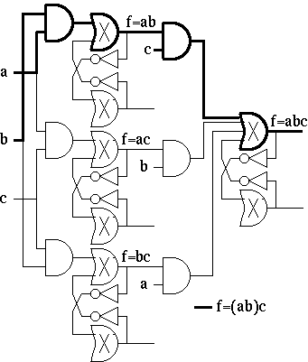

Example: Tree-mapping
Delay: best choice if c is later than a and b.
subject graph library pattern graph

Slide 43
Graph-Mapping: Theory
Graph-mapping( μ ) = min_{θ∈μ} (tree-mapping(θ))
μ: mapping graph
θ: AND2/INV decomposition encoded in μ
Graph-mapping finds an optimal tree implementation for each primary output over all AND2/INV decompositions encoded in μ
Graph-mapping is as powerful as applying tree-mapping exhaustively, but is typically exponentially faster

Slide 44
Λ-Mapping
Given a Boolean network η,
Generate a mapping graph μ:
For each node of η,
  encode all AND2 decompositions for each product term
  Ex: abc ⇒ 3 AND2 decompositions: a(bc), c(ab), b(ca)
  encode all AND2/INV decompositions for the sum term
  Ex: p+q+r ⇒ 3 AND2/INV decompositions:
  p+(q+r), r+(p+q), q+(r+p).
  Apply graph-mapping on μ
In practice, η is pre-processed so
  each node has at most 10 product terms and
  each term has at most 10 literals

Slide 45
Λ-Mapping: Theory
For the mapping graph μ generated for a Boolean network η, let
  L_{η} be the set of AND2/INV decompositions encoded in μ
  Λ_{η} be the closure of the set of AND2/INV decompositions of η under the associative and inverter transformations:
a
b
c
Associative
transform
Inverter
transform
a
c
b
Theorem: Λ_{η} = L_{η}

Slide 46
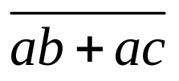
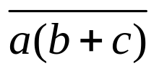
Dynamic Logic Decomposition
During graph-mapping, dynamically modify the mapping graph:
find D-patterns and add F-patterns
b
b
a
a
c
c
D-pattern:
F-pattern:

Slide 47


Dynamic Logic Decomposition
b
a
b
a
b
c
c
b
a
c
a
c
a
Note: Adding F-patterns may introduce new D-patterns which may imply new F-patterns.

Slide 48
Δ-Mapping
Given a boolean network η, generate a mapping graph μ
Iteratively apply graph mapping on μ, while performing dynamic logic decomposition until nothing changes in μ
  Before finding matches at an AND2 in μ, check if D-pattern matches at the AND2. If so, add the corresponding F-pattern
  In practice,terminate the procedure when a feasible solution is found
b
b
a
a
c
c
a

Slide 49
Δ-Mapping
For the mapping graph μ generated for a Boolean network η, let
  D_{η} be the set of AND2/INV decompositions encoded in the resulting mapping graph.
  Δ_{η} be the closure of Λ_{η} under the distributive transformation:
Theorem: Δ_{η} = D_{η}
b
a
b
a
c
c

Slide 50
Δ-Mapping
Theorem: If
  η’ is an arbitrary Boolean network obtained from η by algebraic decomposition.
  θ is an arbitrary AND2/INV decomposition of η’
then θ ∈ D_{η}
The resulting mapping graph encodes all the AND2/INV decompositions of all algebraic decompositions of η.

Slide 51
Solution Space captured by Procedures
η
μ
Phase 1:
arbitrary algebraic
decomposition
Mapping graph
associative transform
L_{η} ← Λ -mapping
Λ _{η}
η'
Phase 2:
arbitrary AND2/INV
decomposition
Dynamic decomposition
distributive transform
η‘’
Λ _{η}
Δ_{η}
D_{η} ← Δ-mapping
Λ-mapping captures all AND2/INV decompositions of η: Phase 2 (subject graph generation) is subsumed
Δ-mapping captures all algebraic decompositions:
Phase 2 and Phase 1 are subsumed.

Slide 52
Experiments
Examples: MCNC’91 combinational benchmarks
Library: From DEC ALPHA microprocessor
Cost: Delay (fastest possible implementation)
Apply four different technology independent SIS scripts on the initial Boolean network.
Encode each of the four optimized boolean network into a single mapping graph μ. (Note: here we encode even more decompositions into )
Apply graph mapping on μ (Λ-mapping).
Collapse the most timing critical region of a mapped network, and encode it in μ.
Apply graph-mapping with dynamic logic decomposition (Δ-mapping)
μ

Slide 53
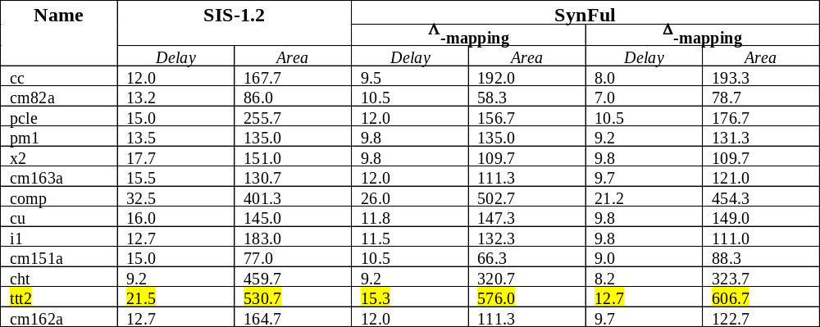
Experimental results
Delay unit: minimum input-output pin delay over all library gates
Area unit: minimum gate-area over all library gates
SynFul’s CPU time: ranged from 10 to 300 seconds on VAXstation 6000

Slide 54
Conclusions
Logic decomposition during technology mapping
  Efficiently encode a set on AND2/INV decompositions
  Dynamically perform logic decomposition
Two mapping procedures
  Λ-mapping: optimal over all AND2/INV decompositions (associative rule)
  Δ-mapping: optimal over all algebraic decompositions (distributive rule)
Was implemented and used for commercial design projects (in DEC/Compac alpha)
Extended for sequential circuits:
  considers all retiming possibilities (implicitly) and algebraic factors across latches

Slide 55
Tree-Covering Approximation
Principle of Optimality: An optimum sequence of decisions has the property that whatever the initial state and first decision are, the remaining decisions must constitute an optimal decision sequence with regard to the state resulting form the first decision
optimum
optimum

Slide 56
Tree-Covering Approximation
Dynamic Programming: (Works for special types of graphs (e.g. trees)).
An optimum solution can be obtained by computing the optimum solutions in order for each subgraph (e.g. sub-trees).
The optimum decision at a node is composed of the optimum at the node plus the optimum costs of the subgraphs at the node. (basically can be proved by induction on the ordering)
Proposition: The minimum area cover for a tree T can be derived from the minimum area covers for every node below the root of T

